Slide 1
The oxidative metabolism of methylotrophic bacteria
These slides were to support (very) informal seminars at UEA as guest of Professor Colin Murrell.
There are separate presentation on cytochromes etc
Almost all the enzymes for the initial oxidation steps to formaldehyde are unique to methylotrophs. These unique enzymes are linked to unusual energy-yielding electron transport chains.
CH₃NH₂
Hydroxylation of methane to methanol [Dalton, Murrell etc]
Oxidation of methanol to formaldehyde [Main topic of this seminar]
Oxidation of methylated amines to formaldehyde [Separate seminar]
Oxidation of formaldehyde to formate [Next slide]
Oxidation of formate to carbon dioxide (typical NAD-linked enzyme)
f) Electron transport chains for energy production

Slide 2
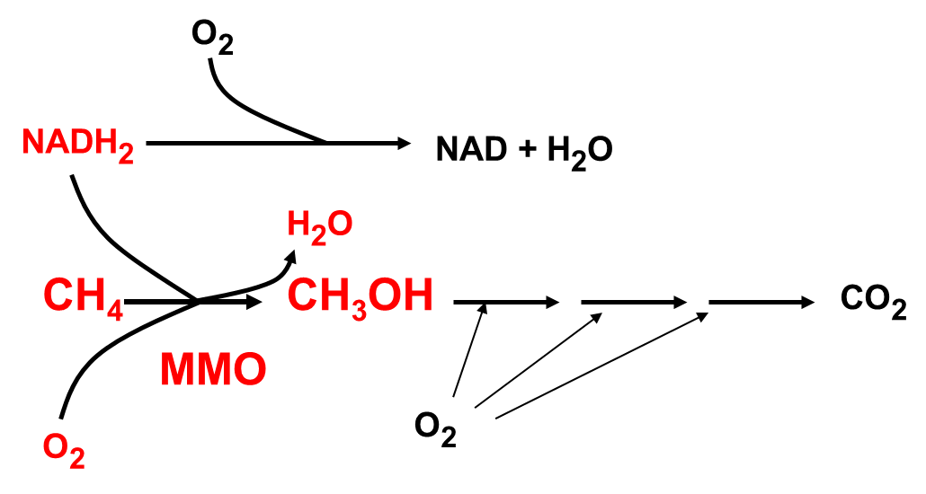
Hydroxylation of methane to methanol
Catalysed by Methane mono-oxygenase (MMO) (Two types)
Soluble (sMMO)
Membrane bounds (particulate or pMMO)
Mainly solved by Howard Dalton; genetics (etc) by Colin Murrell at University of Warwick
More than half oxygen is used by initial hydroxylation in a reaction that requires input of energy (as NADH)

Slide 3
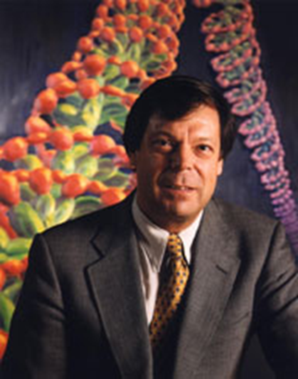
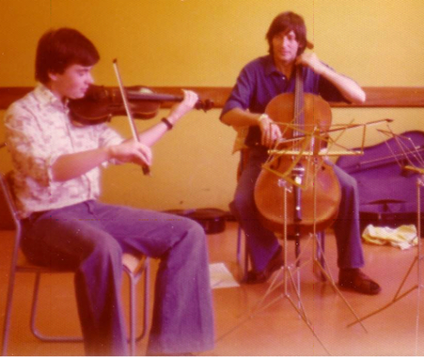
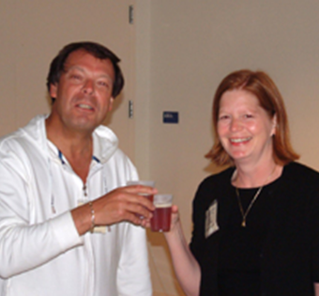
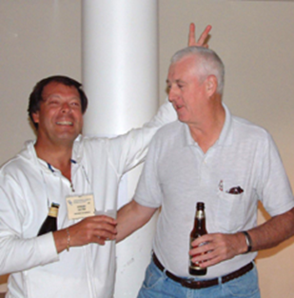
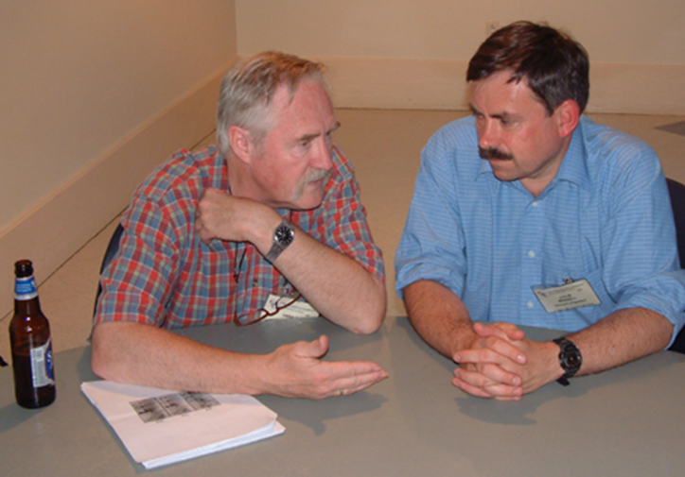
Important people in study of methane oxidation
The late Sir Howard Dalton FRS. Professor Colin Murrell, Mary Lidstrom, Ed Bellion
My second fiddle (juvenile form of Murrell), when I was his tutor at University of Southampton
Nearly adult form

Slide 4
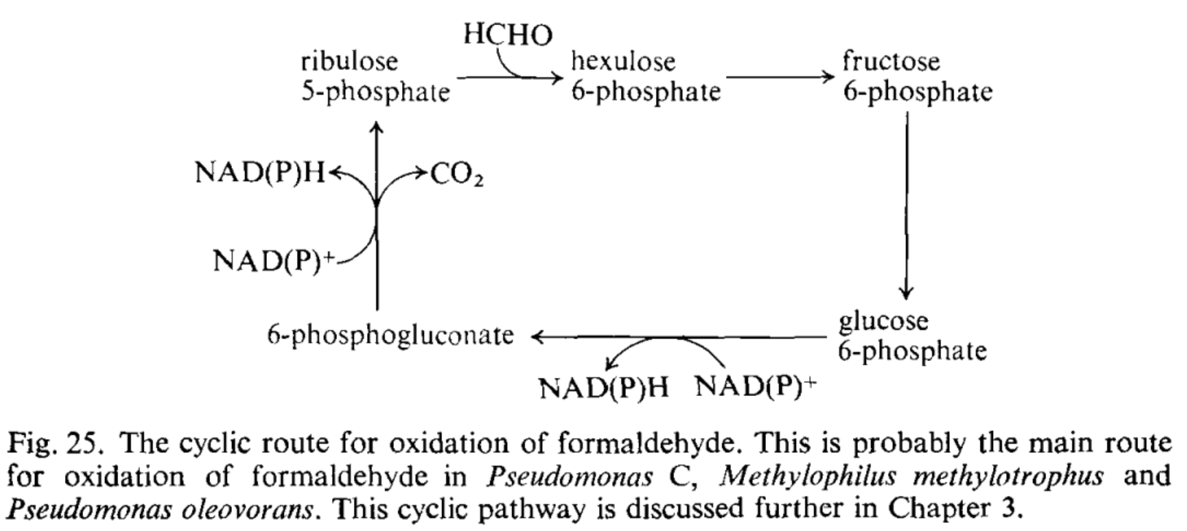
Oxidation of formaldehyde by methylotrophs
Dye-linked dehydrogenases; so possibly flavoproteins or quinoproteins
NAD-linked dehydrogenases. Absolutely essential during growth on methane with
NADH as donor to the hydroxylase
Methanol dehydrogenase. Good substrate but not likely to be relevant.
Complex route involving methanopterin and folates [next slide] (NAD-linked)
Cyclic route in bacteria with RuMP pathway
Note: There must always be routes for removal of toxic formaldehyde. And many aldehyde dehydrogenases are non-specific

Slide 5
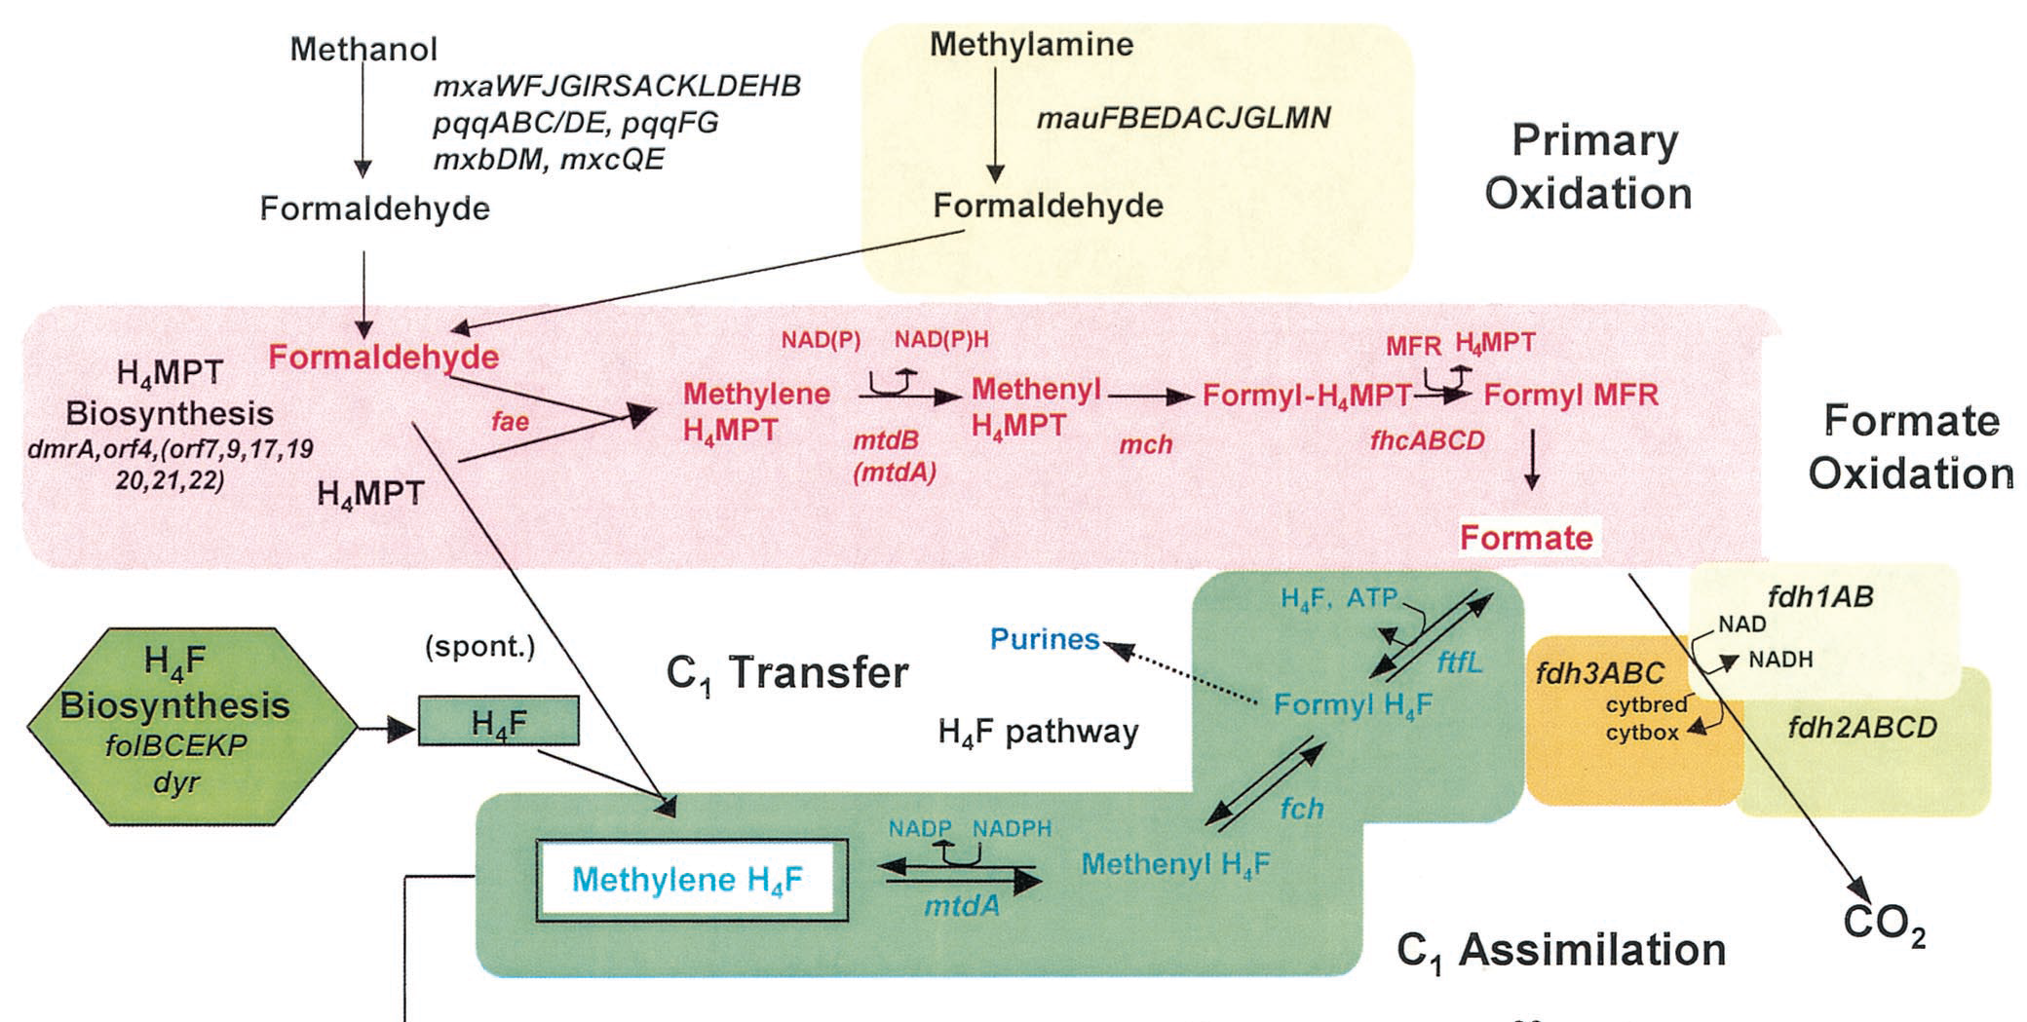
Formaldehyde oxidation in Methylobacterium extorquens
Methanopterin was previously only known as carrier in methanogens. This work is by Lidstrom and colleagues. Much is based on genetic/mutant studies.
Serine cycle

Slide 6
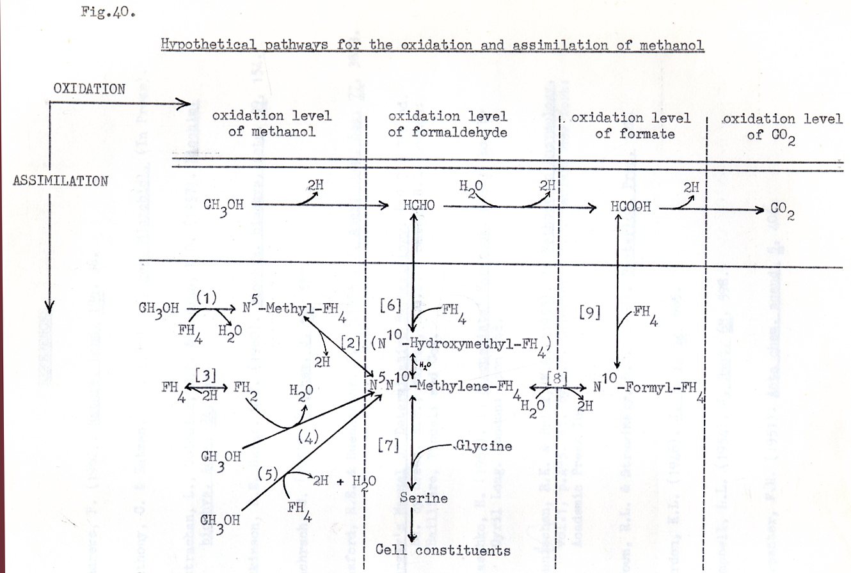
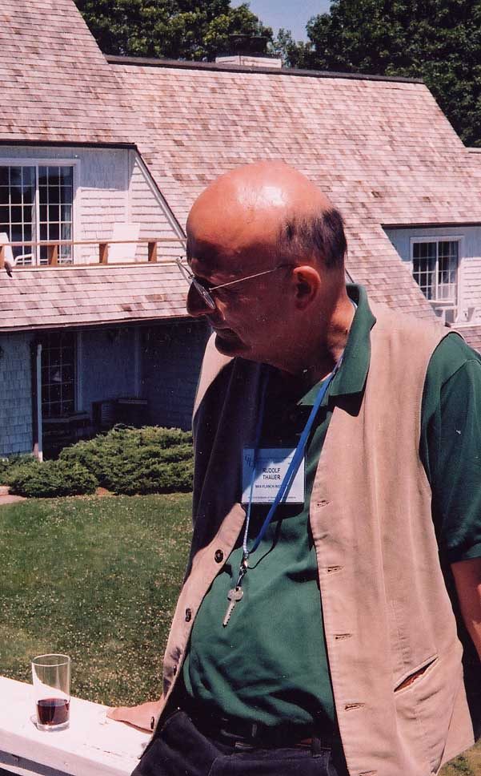
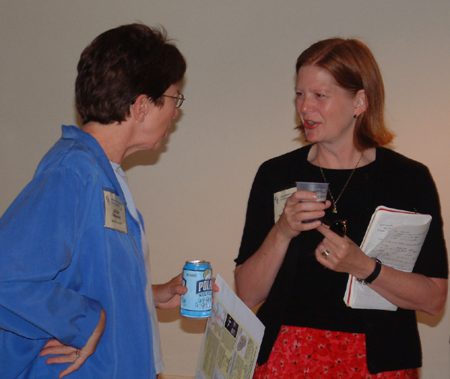

Last page of my PhD Thesis (submitted 50 years ago; May 1963)
suggesting folate involvement in formaldehyde oxidation

Slide 7
The oxidation of methanol in Gram negative methylotrophs
This was my PhD project with Len Zatman (1960-1963). He thought the enzyme for methanol oxidation would be unusual as no NAD-linked alcohol dehydrogenase is able to oxidise methanol.
I started by isolating a soil methylotroph, Pseudomonas sp M27. It was the same as Quayle’s Pseudomonas AM1 (published at end of my first year); now called Methylobacterium extorquens AM1
Whole cells oxidised methanol and a very wide range of primary alcohols
Inhibited by p-nitro- phenylhydrazine. (50% inhibition by 1.0 µM). This has never been explained or investigated further.
Inhibited by EDTA. Not due to chelation of metal ions. Unique to alcohol oxidation. Later shown to inhibit competitively the binding MDH to its cytochrome electron acceptor
Extracts did not catalyse reduction by methanol of NAD but it was possible to get reduction of a blue indophenol dye in the presence of an intermediate phenazine methosulphate using whole cells in anaerobic conditions.
We then found that this assay could be used with sonic extracts: this is similar to flavoprotein dehydrogenases like succinate dehydrogenase.
The enzyme is Methanol dehydrogenase (MDH).

Slide 8
Problems with the dye linked system for methanol dehydrogenase
The rate was not proportional to protein concentration.
No dye reduction could be seen with lower concentrations of extract.
When water in the assay was replaced with salts growth medium the rate became proportional to protein concentration.
The active constituent was ammonium chloride NH₄Cl.
The activator species is Ammonia base NH₃ not the ammonium ion NH₄⁺
This is unique. In some enzymes ammonium ions replace potassium ions. But with MDH ammonium chloride could only be replaced with methylammonium chloride CH₃NH₃⁺
At limiting concentrations of activator 10 times more CH₃NH₃⁺ was required than with NH₄⁺. This is because its pK value is 10 times higher than that of ammonium chloride.
AND 10 times more ammonium chloride was required at pH 8, when the proportion of NH₃ was one tenth of the proportion at pH 9.
NH₄⁺ NH₃ + H⁺

Slide 9
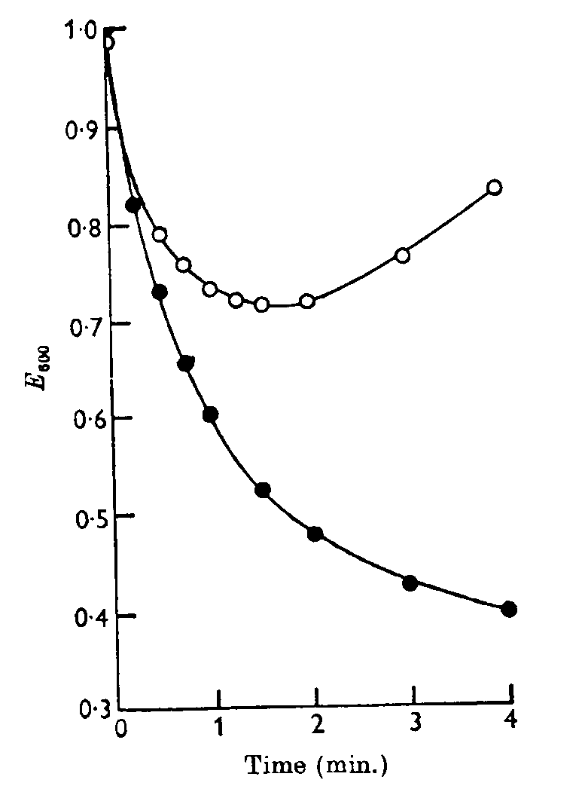
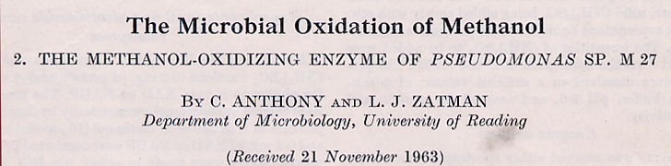
Methanol dehydrogenase
Responsible for all bacterial methanol oxidation
Dye-linked assay (PMS/PIP); pH optimum 9.2; pI 8.2
Activator- ammonia (not NH₄+ ion)
Wide substrate specificity
Unusual absorption spectrum – novel prosthetic group??
High proportion of tryptophans
A homodimer (two 60 kDa subunits); later shown to have two 66kDa subunits and two 8kDa subunits
No metal ion. [Later shown to have Calcium ion]
MDH assay
with PMS/indophenol

Slide 10
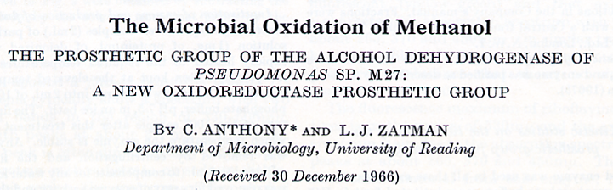
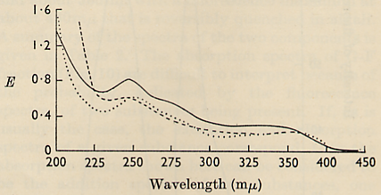
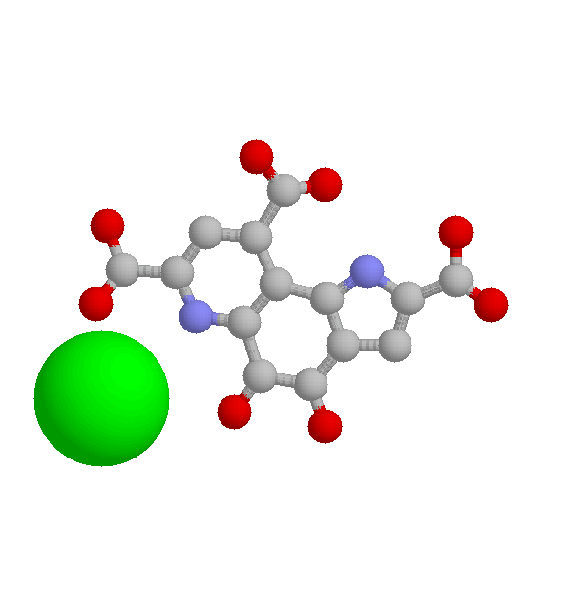
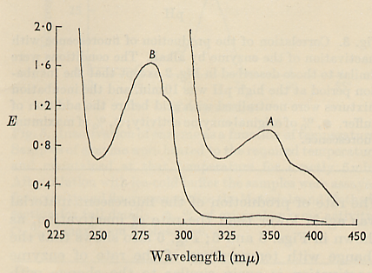
A new type of enzyme prosthetic group
Note: all other dehydrogenases use NAD(P) as hydrogen acceptor or they are membrane flavoproteins that use FMN or FAD as prosthetic group
Spectrum of prosthetic group
PQQ 1979 Kennard’s lab
New prosthetic group is PQQ
Pyrrolo-Quinoline
Quinone
MDH is now known as a Quinoprotein
Ca
Spectrum of MDH
Methanol Dehydrogenase [MDH] 1995

Slide 11
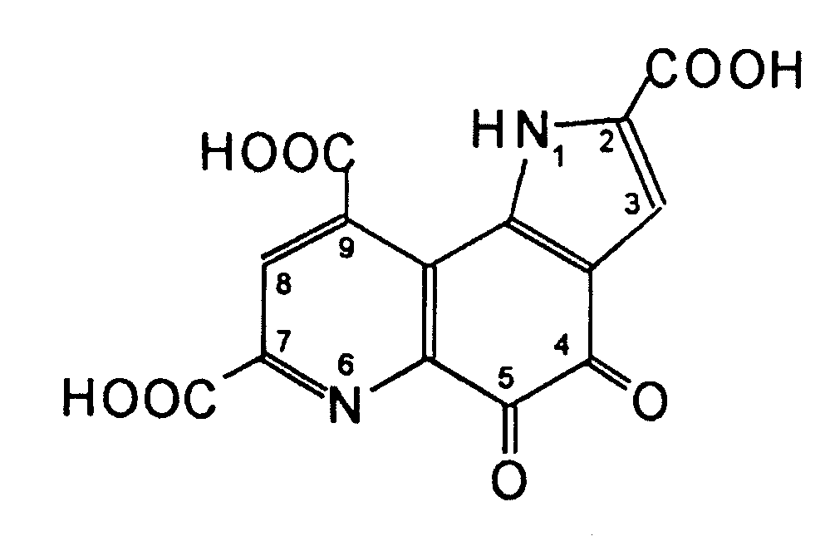
Pyrroloquinoline Quinone (PQQ)
First isolated and purified by Anthony & Zatman in1967 from bacterial methanol dehydrogenase
Structure determined by
Kennard’s group in1979
Quinoproteins are enzymes with an ortho-quinone prosthetic group
They are equivalent to flavoproteins which has riboflavin derivatives FMN and FAD as prosthetic group

Slide 12
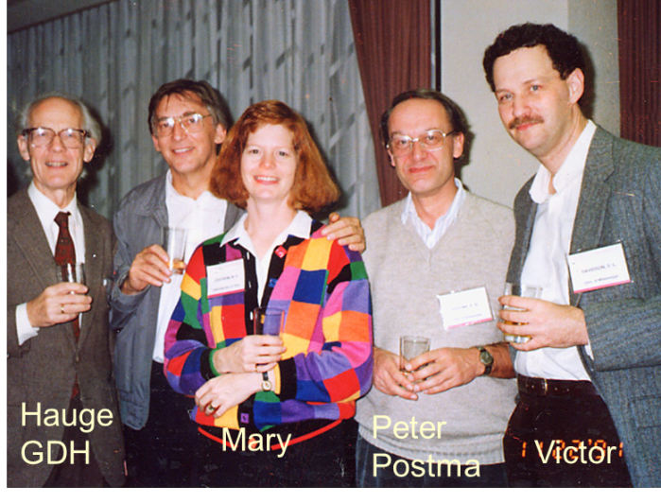
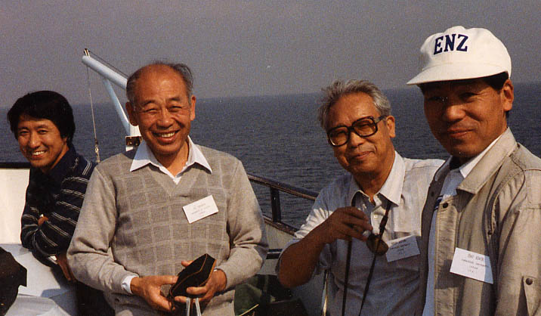
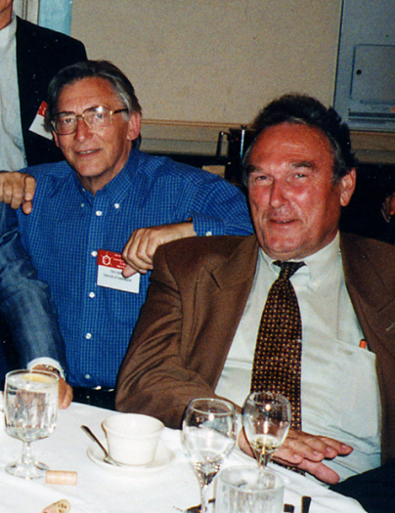
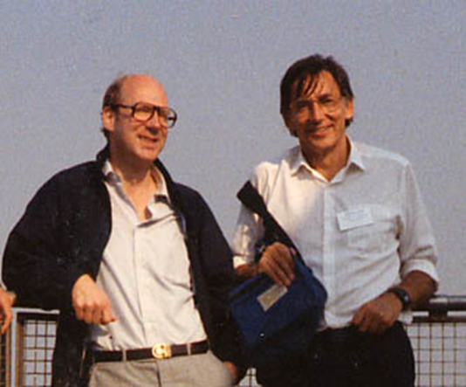
PQQ and other quinoproteins The novel prosthetic group of MDH was later in other dehydrogenases and Hans Duine and Hans Frank called these Quinoproteins. These include the alcohol dehydrogenase of acetic acid bacteria and the typical glucose dehydrogenase in Pseudomonas, E. coli.
Hauge described GDH and PQQ very early on
Friends from Yamaguchi, Japan:
Matsushita, Uragami (?), Ameyama, Adachi.
Found many new quinoproteins especially in Acetic acid bacteria
Note: No PQQ-containing quinoproteins have been described in anything other than bactera
Hans Duine and Hans Frank
‘invented’ quinoproteins

Slide 14


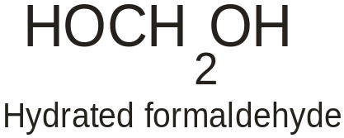
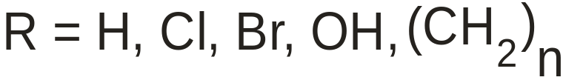
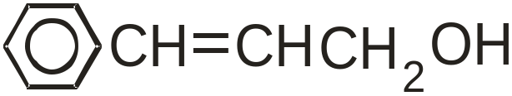

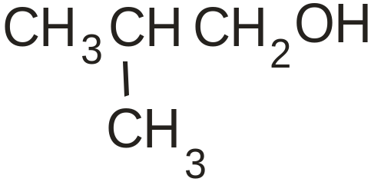
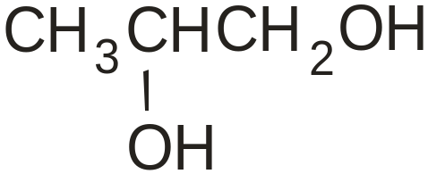
Substrate specificity of methanol dehydrogenase
Substrates oxidised
Only primary alcohols
Substrates not oxidised
Alcohols with C2 substituent
are not oxidised
Surprisingly, propane 1,2-diol is oxidised
But only in crude preparations

Slide 15
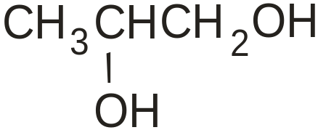
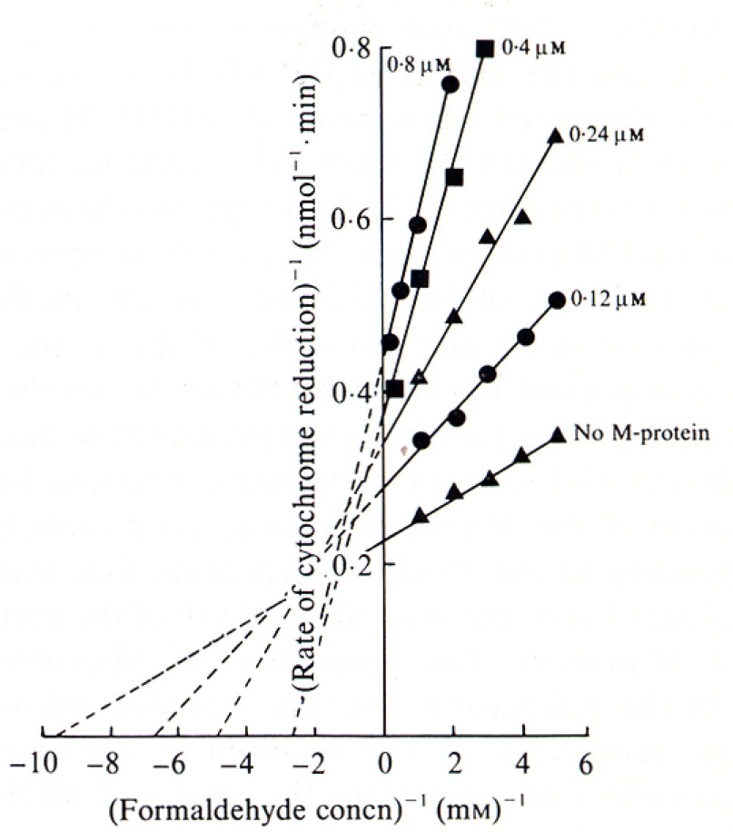
Modifier protein for methanol dehydrogenase
This was found by accident when investigating growth on propane 1,2-diol
This is oxidised by MDH but only in crude extracts;
it does not obey the substrate rules for MDH
The periplasmic Modifier protein increases affinity for propanediol
Surprisingly, it is also present in obligate
methylotrophs that do not grow on propanediol
M-protein decreases the Vmax,
and decreases affinity, for formaldehyde
This prevents the wasteful oxidation of methanol
through formaldehyde to formate
1980-1990:John Bolbot; Steve Ford; Dudley Page; Tony Long

Slide 16
Energy production from methanol dehydrogenase
For energy production the MDH must be linked to the electron transport chain
The cytochromes of M. extorquens AM1
Membranes have typical b-type cytochromes and a cytochrome aa₃ able to oxidise typical soluble mitochondrial cytochrome c.
The Soluble fraction has 2 cytochromes c; one is small typical high pI (cytochrome c_{H}) which is oxidised by membrane fractions. And a much larger one with low pI (cytochrome c_{L} ) which is not oxidised by the membrane oxidase.
Cytochrome c_{L} is a unique cytochrome. It is the electron acceptor for MDH. It is then able to pass the electrons on to cytochrome c_{H} which is oxidised by the membrane oxidase. [There is a separate presentation on these cytochromes]
Proton translocation during methanol oxidation
Measured by typical Peter Mitchell method.
The ratio of protons pumped with pyruvate (NADH), succinate and methanol are 3:2:1.
Conclusion: methanol is oxidised by a unique electron transport chain that is similar to those for oxidation of inorganic ions by chemolithotrophs, where ubiquinone and the cytochrome bc₁ complex are not involved.

Slide 17

Electron transport during methanol oxidation
NADH
2H⁺ + ½ O₂
H₂O
NADH
dehydrogenase
Oxidase
Cyt bc₁
complex
UQ
HCHO
MDH
Cyt c_{L}
Cyt c_{H}
Periplasm
CH₃OH
2H⁺
Stuart Ferguson
Outer wall
During oxidation of MeOH 2 protons are ‘translocated’ from inside to outside
Setting up a protonmotive force supporting production of about 0.6 ATP/MeOH
1975 - 1985
David O’Keefe; Sandy Cross; Mathew Beardmore-Gray; Claude Chan;
Jon Cox; Darren Day; Steve Froud; Andy Elliott; Bill Keevil; Sasha Netrusov; Pat Goodwin

Slide 18


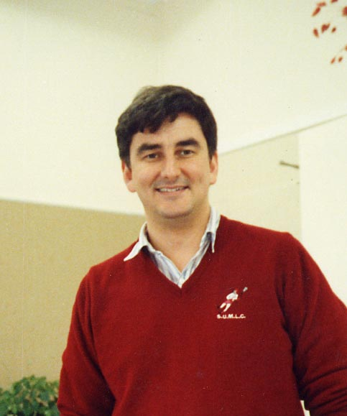



Darren Day
Research students
(Graduated 1990)
Claude Chan
Tony Long
Ian Richardson
Darren
Jon Cox

Slide 19


The second subunit of MDH
1965 - 1989 MDH is a homodimer (2 x 60 kDa); ‘confirmed’ by others for > 20 enzymes
1989 Jim Elliott insisted that his 8.5 kDa ‘contaminant’ must be a subunit
1986: The key papers starting genetics of the
methanol oxidation system
Nunn & Lidstrom (1986a,b) J. Bacteriol. 166
1989 We (David Nunn) sequenced the gene for
cytochrome c_{L} (mxaG); and showed that the
downstream gene (mxaI) in the methanol oxidation
operon coded for the ‘contaminant’ which thus
became the 8.5kDa ß subunit
1989 Darren Day confirmed that MDH is an α₂ß₂ tetramer

Slide 20
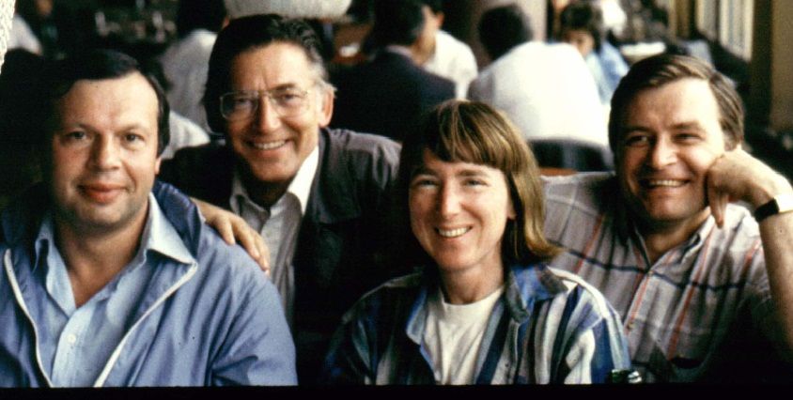
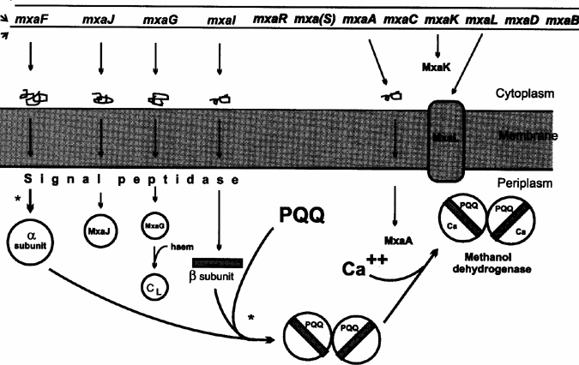
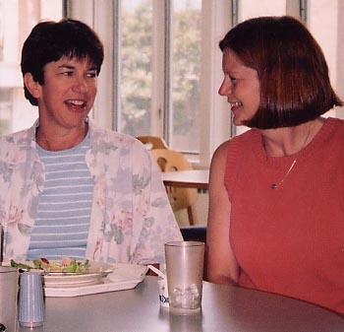


Expression of the mxa operon
Yuri
Sasha
Pat
MxaL
Mary
Karen
Amaratunga
The genes: Nunn, Lidstrom, Amaratunga, Anderson, Anthony, Goodwin, Morris, O’Connor

Slide 21
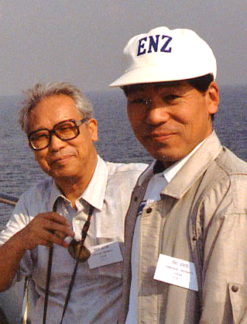

The calcium ion in MDH
1965-1989 ‘ MDH contains no metal ion’ [Anthony & Zatman]
1986 MDH from mutants (mxaA, K & L) was inactive and
had unusual spectrum [Nunn & Lidstrom]
1990 MDH contains Calcium (or strontium) [Adachi et al.]
1992 Other MDHs contain calcium.
MDH from mxaA, K & L lacked Calcium;
incubation with Ca produced active enzyme
& normal spectrum [Ian Richardson]
Ameyama
Adachi
1992 MDH isolated from marine Methylophaga
Marina is red and inactive;
incubation with Ca produced
normal green active enzyme [Claude Chan]
Ian
Claude
Jon

Slide 22
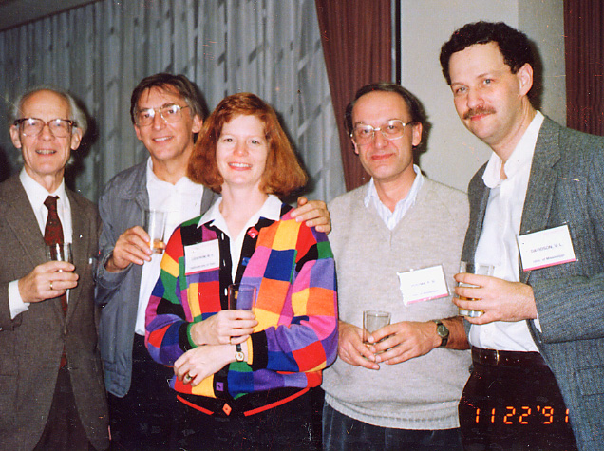



The calcium ion in MDH
1994 Kinetics of MDH containing
strontium [Harris & Victor Davidson]
Hauge
GDH
Peter
Postma
1996 Incubation with Barium produced MDH which was more active than
wild-type MDH [Matt Goodwin, Alain Avezoux & Simon Dales]
Mary
Victor
Alain
Matt
Simon

Slide 23
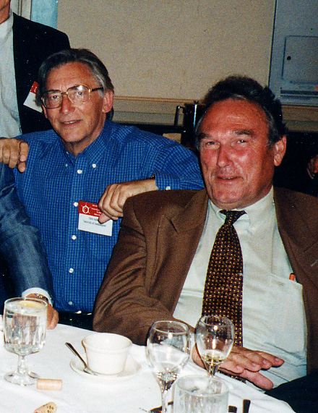

The Mechanism of MDH
1979: X-ray structure of PQQ; Salisbury, Forrest, Cruse, Kennard
1978 – 1991: Main work on the mechanism; Hans Frank and Hans Duine
Ping-pong reaction with PQQ quinol produced from quinone
Reaction is catalysed by an active site base;
Addition/elimination reaction with a covalently attached methanol
Hans Duine
Hans Frank

Slide 24
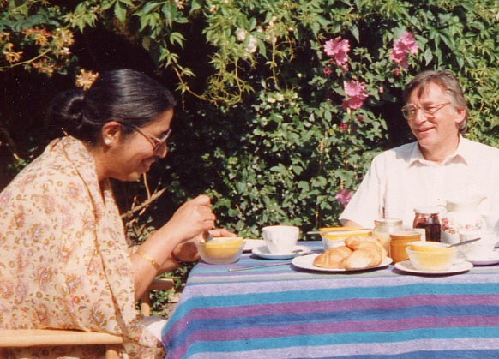
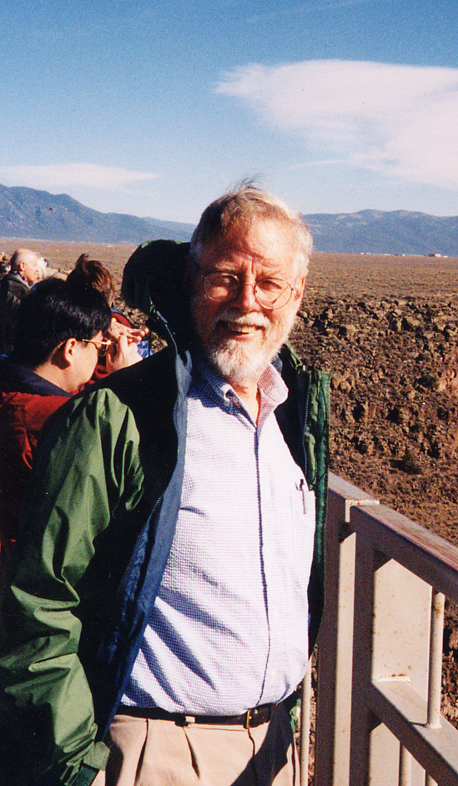
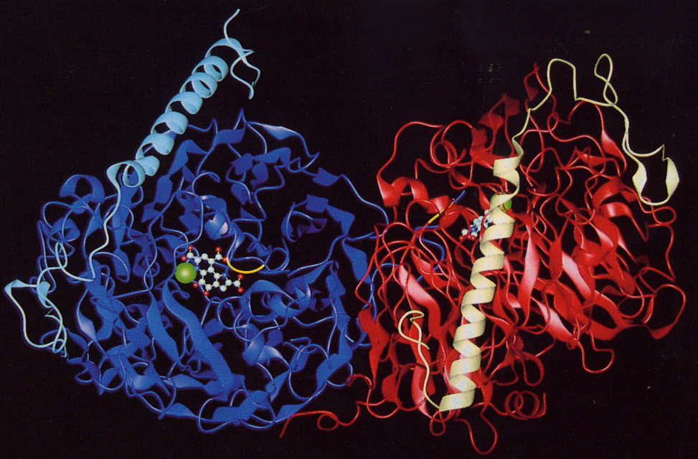
The X-ray structure
of MDH (1992 – 2004)
Meenakshi
Ghosh
Scott Mathews
Meenakshi Ghosh, Chris Anthony; Colin Blake, Alain Avezoux, Matt Goodwin
Scott Mathews, Z-X Xia, Victor Davidson, Scott White et al.

Slide 25
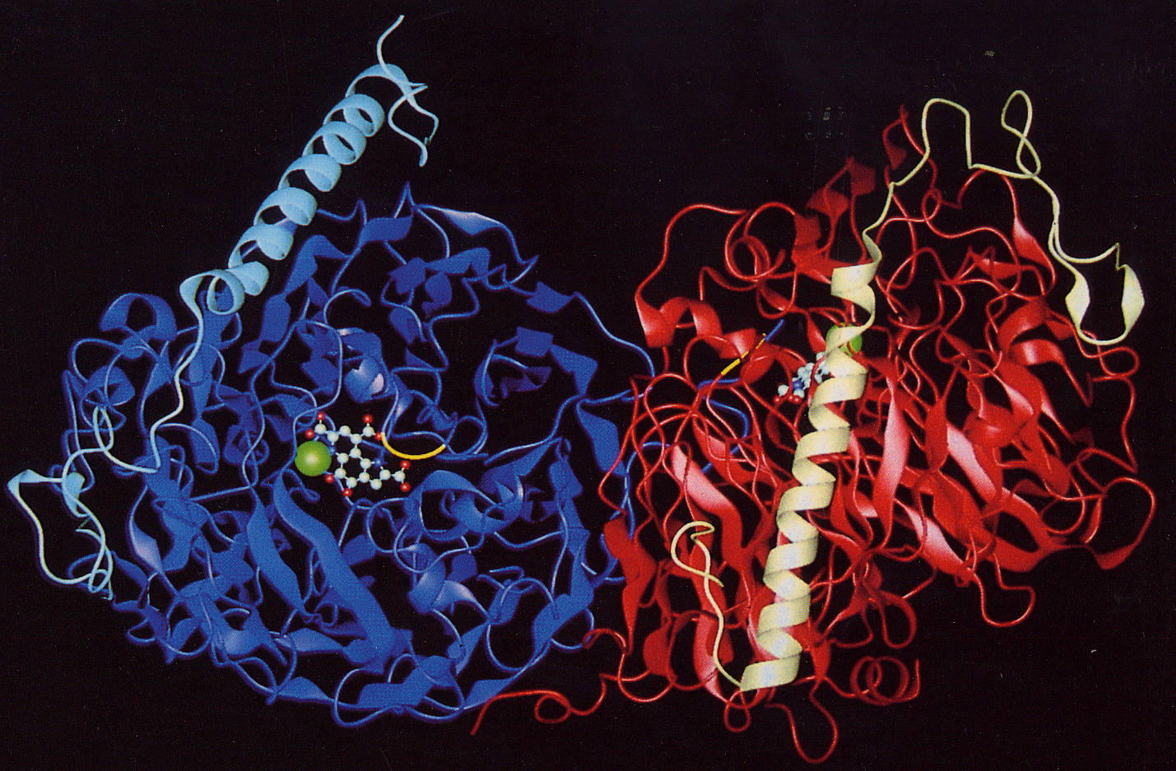
The structure of MDH of M. extorquens
The α₂ ß₂ tetramer
Meenakshi Ghosh, Chris Anthony; Colin Blake, Alain Avezoux, Matt Goodwin
Scott Mathews, Z-X Xia, Victor Davidson, Scott White et al.
1992 - 2003

Slide 26
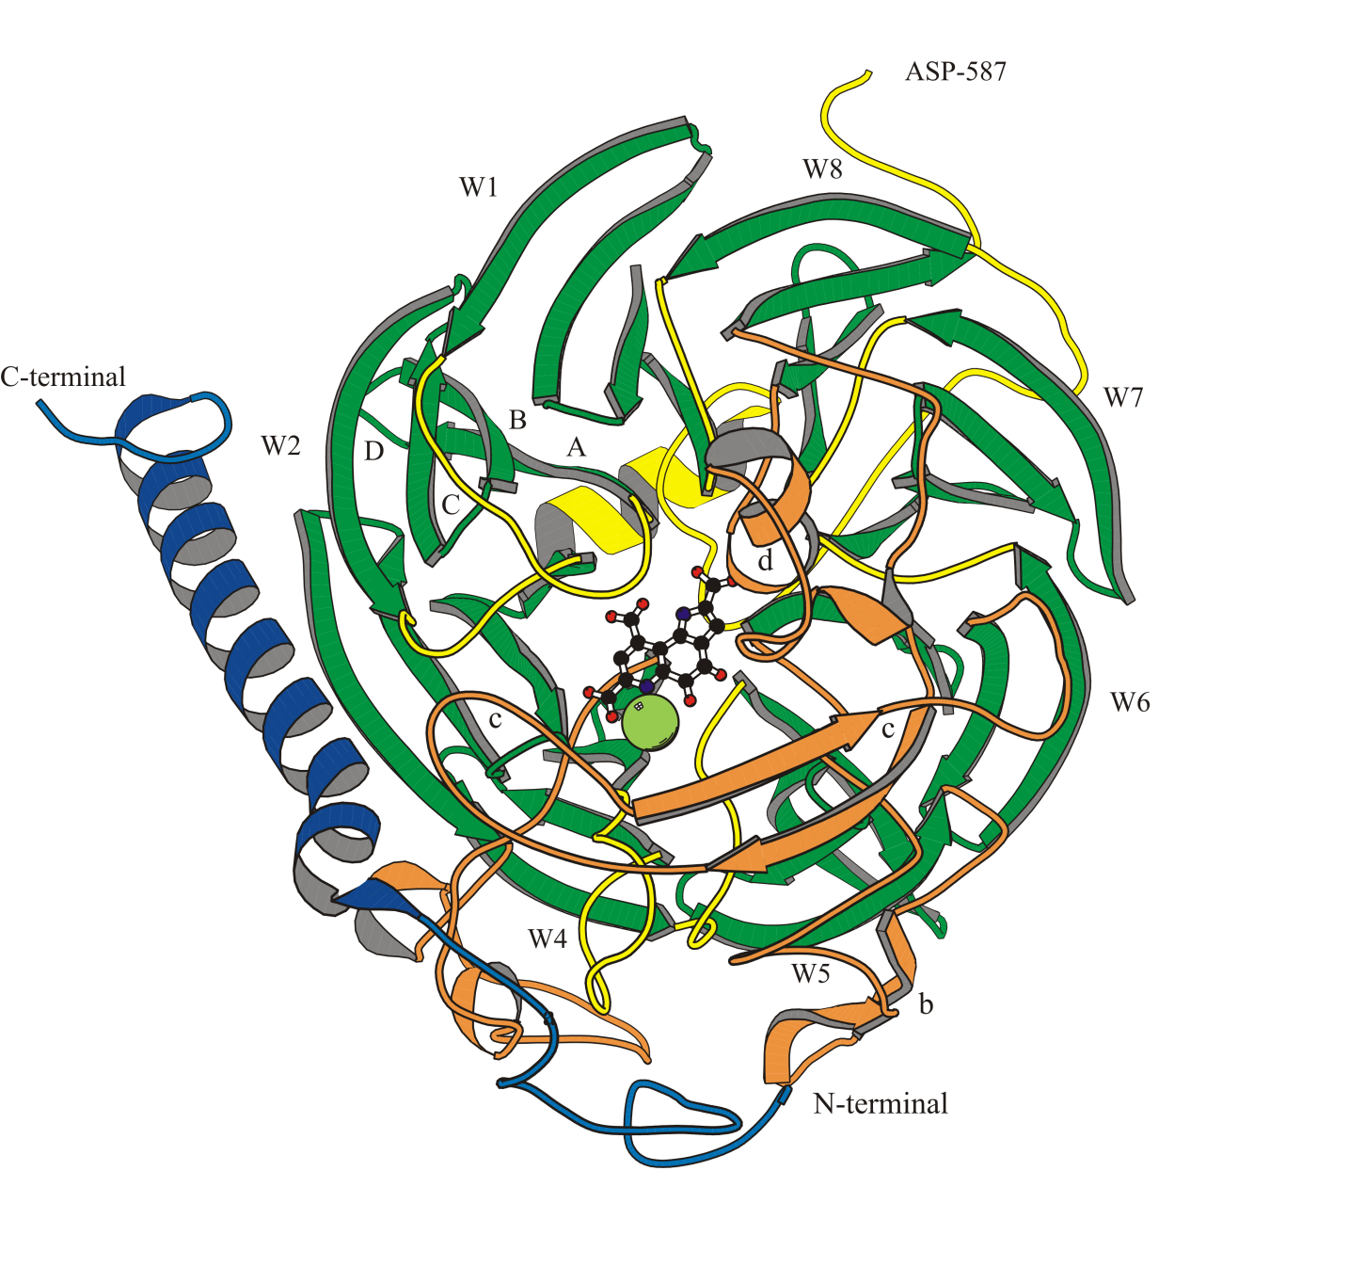
The ß-propeller structure of MDH
Eight 4-stranded ß sheets (W1-8);
these are ‘propeller blades’.
The ‘propeller fold’ forms a
superbarrel with active site inside
Active site contains PQQ
and calcium (green sphere)
The ß-sheet ‘propeller blades’ are held
together by ‘tryptophan-docking motifs’

Slide 27
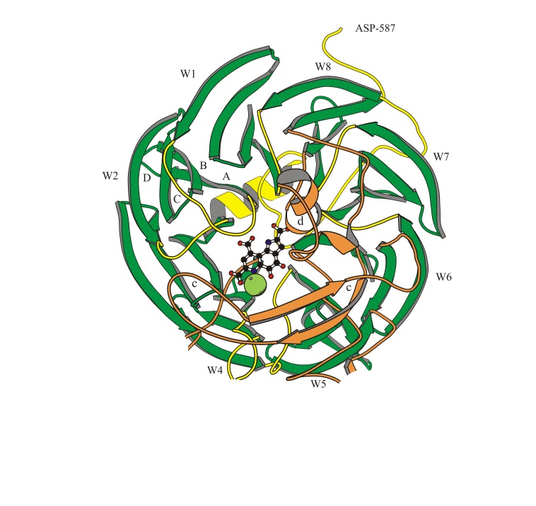
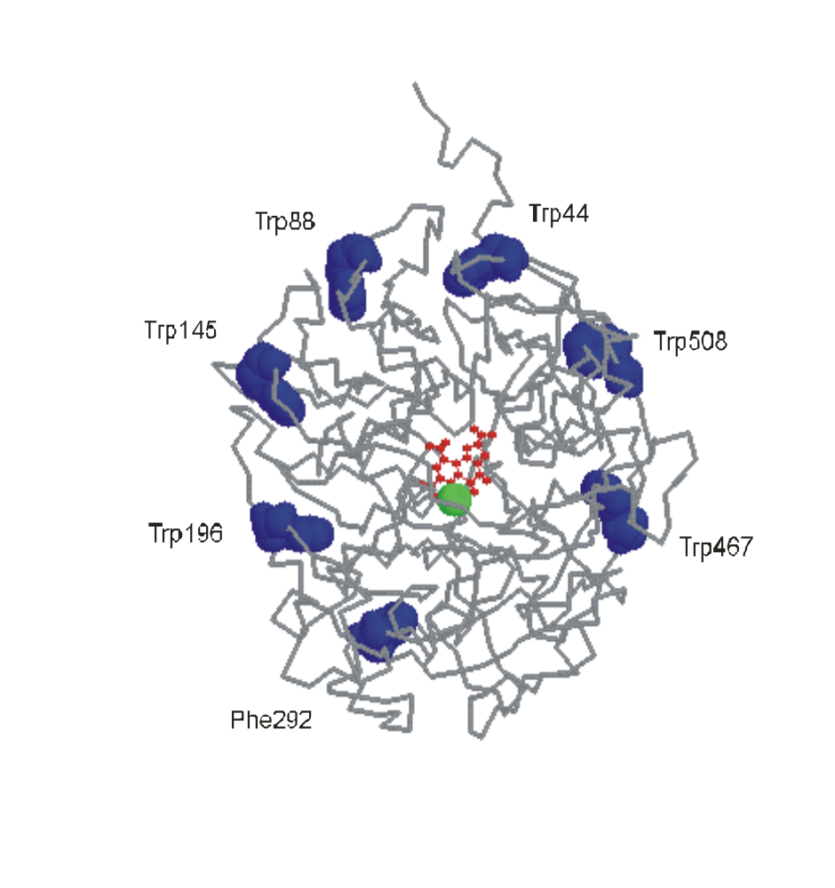
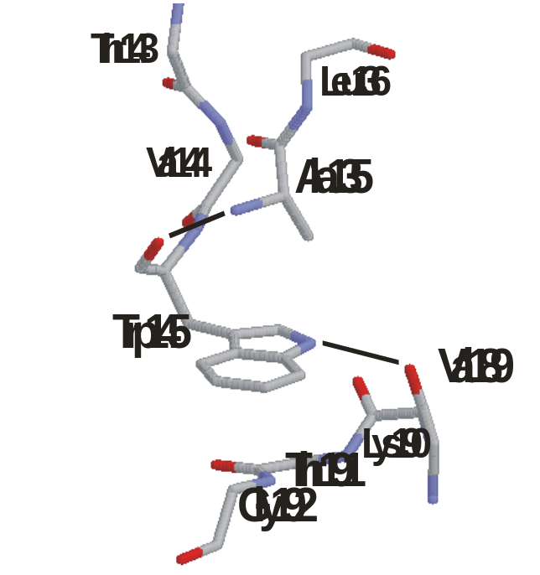
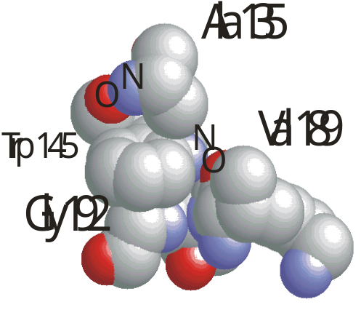
Tryptophan docking system
High proportion of tryptophans;
19 per α subunit
The ß-sheet ‘propeller blades’ are held
together by ‘tryptophan-docking motifs’

Slide 28
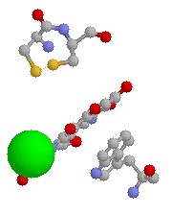
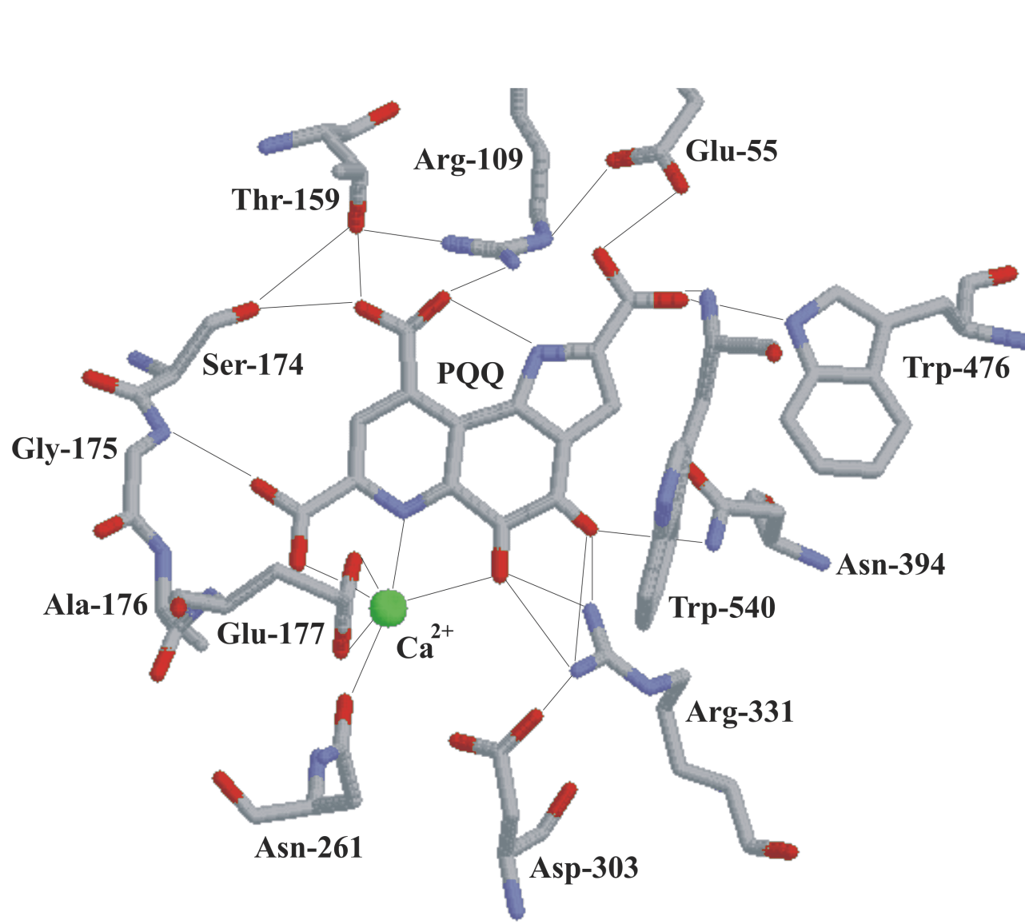
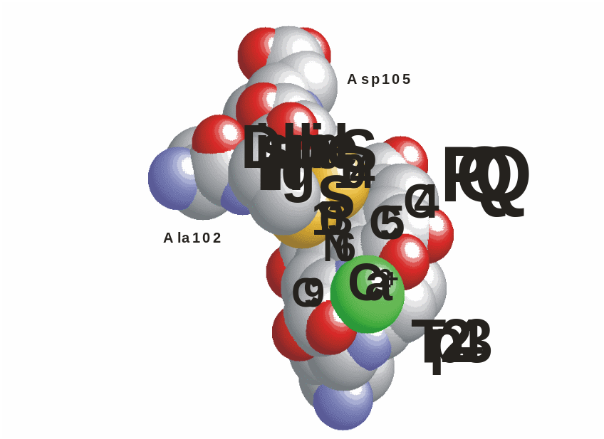
The active site of MDH
Ca
Novel disulphide ring structure
from adjacent cysteines

Slide 29
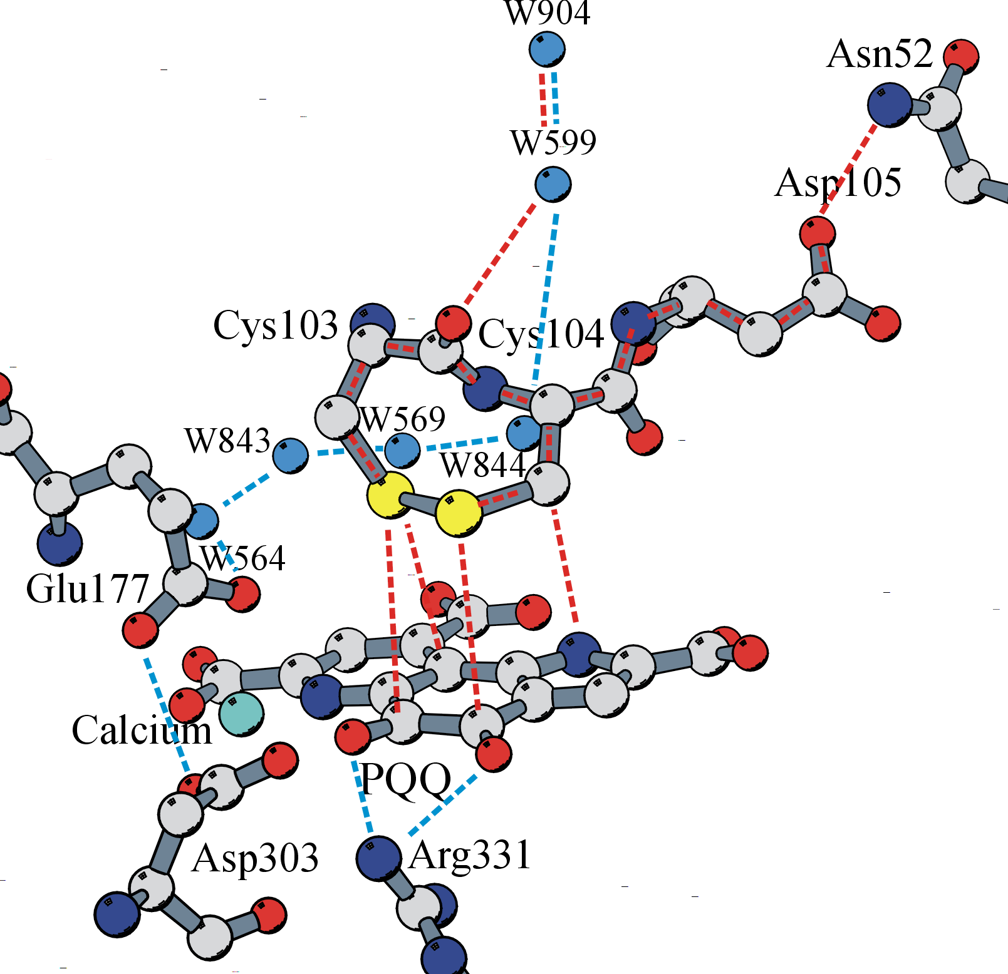
The path of electrons and protons during the oxidative part of the reaction mechanism of MDH
Electrons must pass from reduced PQQ (PQQH₂)
to cytochrome c_{L}
Cytochrome c_{L}
Note involvement of the disulphide ring
Protons must pass from PQQH2
by way of its hydroxyls, and the
hydrogen-bonding network, to the water (W904)
which is accessible to the periplasm
The pathways are based on those
proposed for the quinohaemoprotein
alcohol dehydrogenase by Oubrie,
Dijkstra et al, and Chen, Matsushita,
Toyama, Scott Mathews et al.

